Slide 1
What is Person Centered Thinking and Person Centered Planning… Myths and Realities
Person Centered Planning Series
Part 1
Notes:
Welcome
Thank you for joining us
We are excited to bring part one in a three part webinar series focusing on Person Centered Planning
I this entire series we will have conversations about
Person Centered Thinking
Person Centered Planning
And
Person Centered Doing
We hope you will be able to join us for all three webinars
Ending the 4th installment with a FREE Training of Trainers for PATH.
SO LET’S GET STARTED WITH OUR
WHAT IS PERSON CENTERED THINKING
AND
PERSON CENTERED PLANNING
MYTHS AND REALITIES….

Slide 2
What is Person Centered Planning?
Person Centered Planning is the practice of defining a meaningful life that centers around an individual’s hopes, dreams, and capacities. The Person Centered Planning values the input of the person first. Trusted people in that person’s life are invited to contribute to the overall accomplishment of a desired quality of life.
Notes:
We will unpackage this definition through out this webinar.

Slide 3
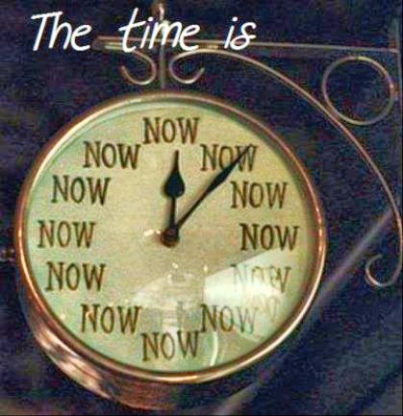
Why Now?
Notes:
Begs the question to be spoken…
If not now when?
A gentle reminder
Some of us have been doing this work for years
Since in and around 1985 to be exact
There is a renewed interest in PCP work.
A movement growing that requires a culture and systems change
As the pushback from funders such as CMS , school dollars ,federal and state dollars adult servies require more and more of us to embrace PCP work because they realize the value of the work.
Lets not go to the place of fear
Fear we don’t have enough time
fear we don’t have enough resources
We can Create learning environments as opposed to fear based environments.
We can Build capacity within our systems to support each other in our work
CEA work…
This is the time of opportunity to build a truly person centered service system
That is responsive to the individuals desires

Slide 4
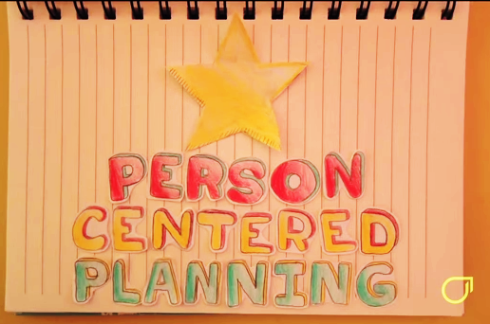
Person Centered Planning Verses System Centered Planning
In this video clip Beth Mount describes how Person Centered work differs from System Centered work.
Notes:
Credit to Open Futures Learning – Inspirational training for the developmental disability workforce.
http://www.openfuturelearning.org
Back up
PCP
We focus on the person
Their gifts and capacities
And look for welcoming places in the communities where the person’s gifts will be gladly accepted and appreciated.
We realize lots there is a lot of individualize PCP work happening
We are looking to operationalize The practice o f PCP work across organizations, schools and the service delivery system.
PCP change challenges us to discover and invent a personal dream for people.
To craft a pattern of living that increases people’s participation and belonging in community life.

Slide 5

How do we begin our Person Centered Thinking?
The answer to HOW is YES!
Notes:
Peter Block encourages us to say “yes’ to our ideals and act on what we know to be true.
Yes we can do this as passionate thinkers
Yes we can think of better ways to bring the person’s hopes, dreams and desires into our day to day work.
We can utilize “collective wisdom”
The wisdom that is available to us a group that might not necessarily be available to us as individuals.
Let’s
Bring “YES” into practice.

Slide 6

Value Check
What do we value about Person Centered work?
All people have gifts and capacities.
People can have valuable contribution to their communities.
Welcoming communities benefit from the persons gifts and capacities.
People are entitled to PCP as well defined processes that help them achieve a meaningful quality of life.
The tools we use are time tested and people tested.
We facilitate our tools with integrity and fidelity.
Trusted people can change their perceptions of what is possible.
Notes:
We meaning practitioners of Person centered work.
What are we acknowledging or affirming ?
The story of young man just moved out his own
We are the world dads comment
I will never look at my son in the same way
Japanese Symbol that represents Discipline and Integrity

Slide 7
Putting our Person Centered Thinking into Practice
Step by Step
One Person at a time
Notes:
Start one person at a time there is a chain REACTION WITH THE PERSON.
Other s witness
the movement grows.
I want that too!
moves to
From one person can radiate to community life how others perceive the individual.

Slide 8

We Have a Conversation With the Person
Get permission
Notes:
Always start with the person
Explain to the individual…
We are going on a journey
A journey of self- discovery
To identity what matters to you about your future.
We will try to answer these questions and many more…
Where you see yourself
Where are you living
who is in your life
What you are doing to make a living
Where do you feel welcomed
What will make you proud of yourself?
Can we take this journey of exploration together?

Slide 9

We Listen
Notes:
It ‘what we all want
Someone to listen
Shows we care
Listen deeply to this person’s language , whatever that might be.
We all know people who are non-verbal have their own communication style.
Device, sounds , gestures

Slide 10
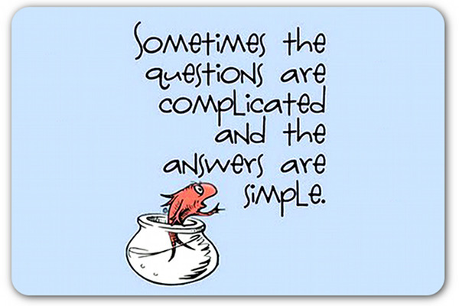
We Honor Relationships
Who are the trusted people in the person’s life?
What can we do to build healthy relationships?
How can we grow the circle of support?
Notes:
Well intentioned people might want to be part of the planning
I tell them “not to worry, we will have an assignment for you
After we hear what the person needs to accomplish their dreams and aspirations.
We are creating a safe place for the conversation.
Building relationships
Be with other like-minded people
Hang where they hang
Be where they are
Go to where they get inspired
Instant conversation starters possibilities.
Life with but also beyond the family…

Slide 11
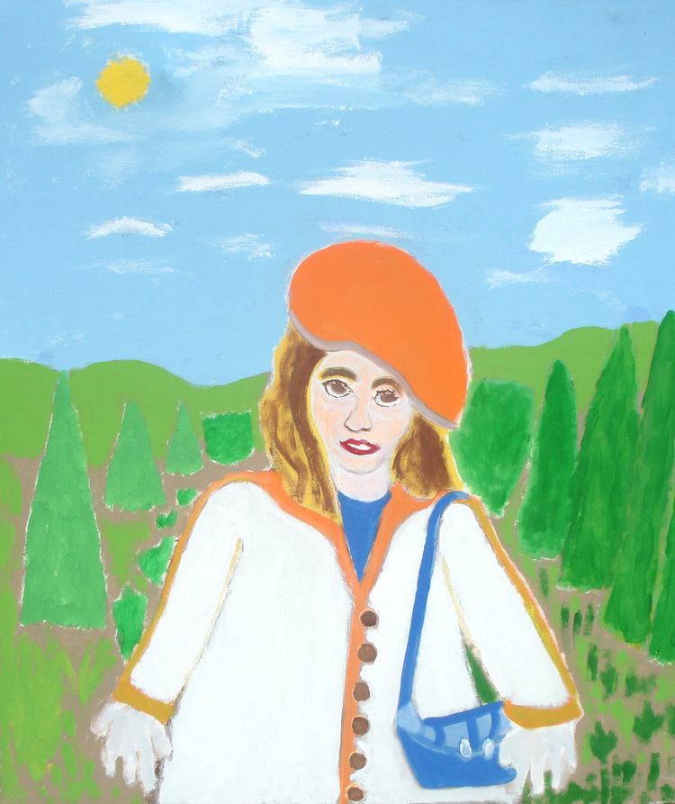
We Keep the Person at the Center
Notes:
Anthony Pontarelli
Anthony Pontarelli is a classic figurative artist who channels both his experience and his dreams into lush and layered paintings that defy categorization. People and animals float through landscapes, bending and changing into symbols or objects, in a unique, timeless harmony.
Top Drawer Art at The Brass Warren RI
We pay attention to the person gifts and capacities and find ways for the individual to
Actively be come the person they want to be.

Slide 12

We Respect Culture
“Culture is the widening of the mind and of the spirit.”
Jawaharlal Nehru
Notes:
Culture is the widening of the mind and of the spirit.
Jawaharlal Nehru
It feeds our soul
It comforts us
Lets us know we are not alone
We value our traditions and create new ones along the way
Ashley’s story inviting and trusting supports into the family home.
We demonstrate our respect for the person’s culture by finding ways to deepen their
Cultural connections in meaningful ways.

Slide 13
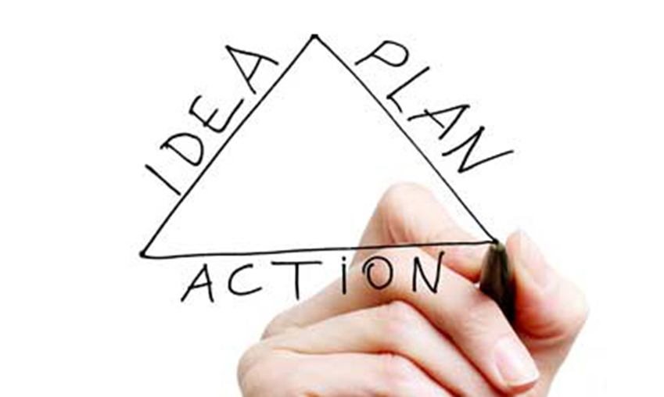
We Take Action to Make Dreams Positively Possible
If we can not make the whole dream come true , what is the part of the dream we can make happen?
Notes:
Story time
Airplane pilot

Slide 14

We Identify Welcoming Places
Open doors to welcoming places that will gladly receive, honor, and celebrate the individuals gifts.
Notes:
Why waste our time in places that are not welcoming?
PCP helps the person identify their gifts
We know the gifts
We figure out where will their gifts be accepted and appreciated in their communities.
Story time

Slide 15

We Build Capacities
A world that works for everyone.
Notes:
We build capacitates as well change societies' perceptions along the way.
People will be seen in a different light.
Unique perception of the how to be in the world
Remind us of our best selves.
We gain insight into our lives as well when we do this work.
John and his mom story

Slide 16
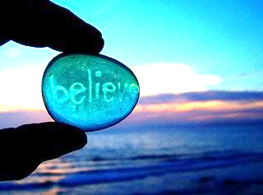
We Commit to Inclusion
This unique individual has valuable contributions to make to their community.
This person’s gifts and capacities can aid the needs of the community.
People will have status in their communities.
Notes:
Look at community
What is missing
How can this person's gifts contribute to the betterment of their community?
Valued status in their communities
Beth Mount work NY Bronx

Slide 17
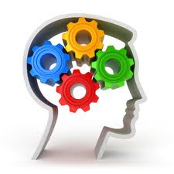
We Change Workplace Culture
How do we honor people’s choices?
What actions do we take that show the person our commitment to their dreams?
How do we help others understand our mission?
How do we support each other with person centered work?
Notes:
Are we honoring peoples choices or making choices for them
Do we have a plan of action?
Like visiting the airport
Is the person or family willing to share their successes?
How do we build communities of practice?
Connect the dots
Person …. gifts ….community inclusion

Slide 18
Person Centered Planning
Facilitating
Conversations That Matter.
Notes:
To the person…

Slide 19
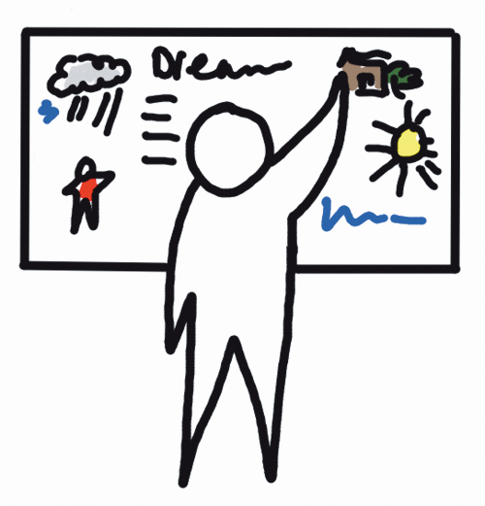
It all starts with a dream…
Notes:
Dreaming Big with a capitol “D”
We need to vocalize
“no one can edit people’s dreams”
We encourage the person to thin k large better best of all worlds

Slide 20
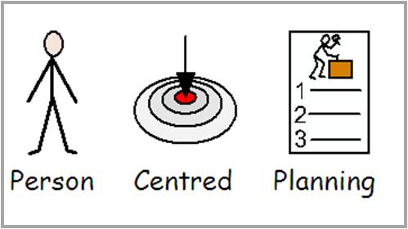
It’s what we do…
Notes:
Person centered Planning means exactly that
The person
Is at the center of our work
And we plan with them
We will be talking more about the tools we use with PCP work in webinar 2
Webinar 3 will give you some tips for facilitating PCP and a view of what it is like to be a facilitator

Slide 21
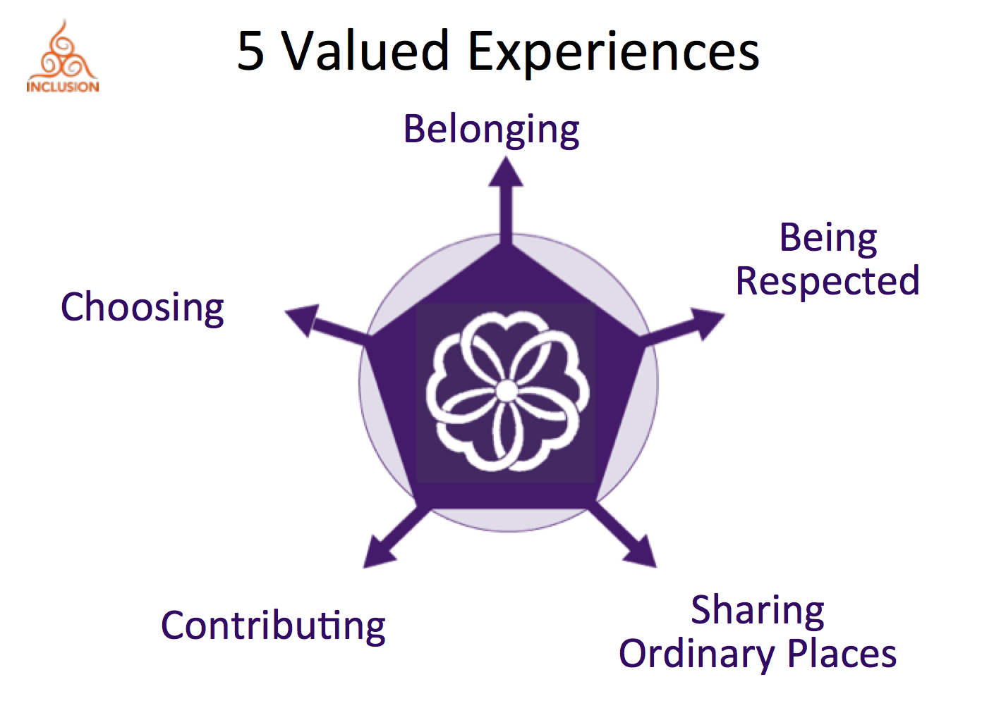
We focus our Person Centered Planning on…
Notes:
A valued life for anyone
A life worth living
Common experiences to help developed a more desirable future using Person Centered Planning.

Slide 22
Person Centered Planning Myths and Realities
Where the rubber meets the road

Slide 23
We realize we have done our Person Centered Planning work well when…
The focus person’s voice is heard.
The individual is actively involved in the process to the best of their ability.
The person communicates (in their own communication style) a sense of knowing this is
“all about me!”.
Pride of ownership is witnessed.
Trusted people now have a clearer picture of “What is possible.”

Slide 24

We realize the challenges
Person Centered Planning Myth Busting
Myth PCP is accountability for a system.
Myth
PCP will happen by itself.
Myth
There are no conflicts with PCP.
Myth
Is facilitated by one person.
Notes:
Current system is evolving to be more PC as opposed to system centered
Just because the consent decree in RI states student and adults with IDD are entitled to PCP processes does not mean it will magically happen occur.
Takes a community of dedicated practiconers.
Communities of practice.
Practioners come together to learn and grow their capapties as facilitators of PCP tolls and facilitation strategies.
CEA will be hosting learning

Slide 25

“Life is not a problem to be solved, but a reality to be experienced.” Soren Kierkegaard

Slide 26



Thanks to the Visionaries
The work of the following people (and many other visionaries) can be found on Inclusion Press, Open Future Learning and/or Amazon:
Jack Pearpoint
John O’Brien
Marsha Forest
Connie Lye O’Brien
Lynda Kahn
Beth Mount
Michael Smull
Peter Block
www.amazzon.com www.inclusion.com

Slide 27

Brought to you by…
www.cea.fedcap.org

