Slide 1
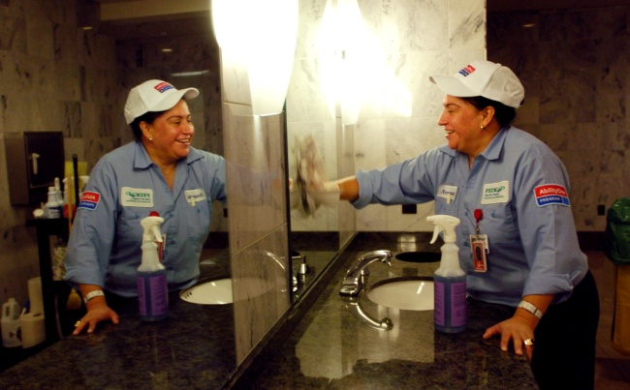
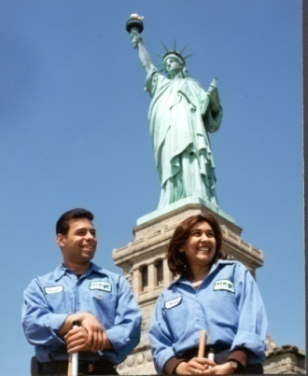
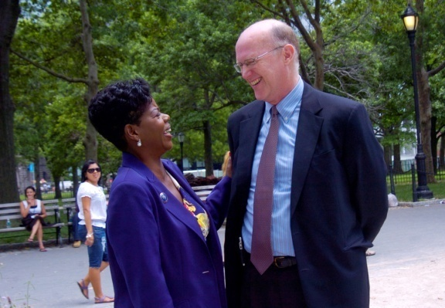
Moving from Work Centers to Community Based Employment

Slide 2
The Culture
“I did then what I knew how to do. Now that I know better, I do better.“
Maya Angelou

Slide 3
Fedcap History
Fedcap is the result of the vision and persistence of 3 World War I veterans who returned from war with significant battlefield injuries, and were unable to find their place in society.
In 1935 they launched the Federation for the Handicapped—with the goal of ensuring that people with disabilities who wanted to participate in life to the fullest —could.
Their commitment to the employment and economic well being of people with barriers still drives us.
Their innovation spearheaded the social impact commercial businesses model that provides living wage employment, benefits and career paths for individuals with barriers.
Throughout our 80 year history we have pioneered employment for veterans and people with physical and developmental disabilities as well as, transportation, recreation and rehabilitative services.

Slide 4
Fedcap Today
Impacts the lives of 65,000 people each year
Services located throughout the Northeast, New England, Mid-Atlantic and Southeast
Work is structured within four practice areas:
Workforce Development
Education
Occupational Health
Economic Development
Work is informed by the Community Impact Institute—the discovery, research, and writing arm of the agency

Slide 5
Background: Fedcap’s Work in Rhode Island
Interim Settlement Agreement and Consent Decree
Transformation from center-based work to integrated employment
Responsible for closing down of sheltered workshop and RAPID integrated employment of individuals named in the ISA
Providing technical assistance and training to 40+ community agencies and 39 school districts
Shifting the culture and changing the lens
Moving from more traditional vocational rehabilitation approach to Rapid Job Placement

Slide 6
Definition of Rapid Job Placement
Historically in the vocational rehabilitation world we “readied people for employment” for months/years
Rapid Job Placement means that when the job is identified people go to work
Businesses must be engaged, jobs identified/ developed

Slide 7
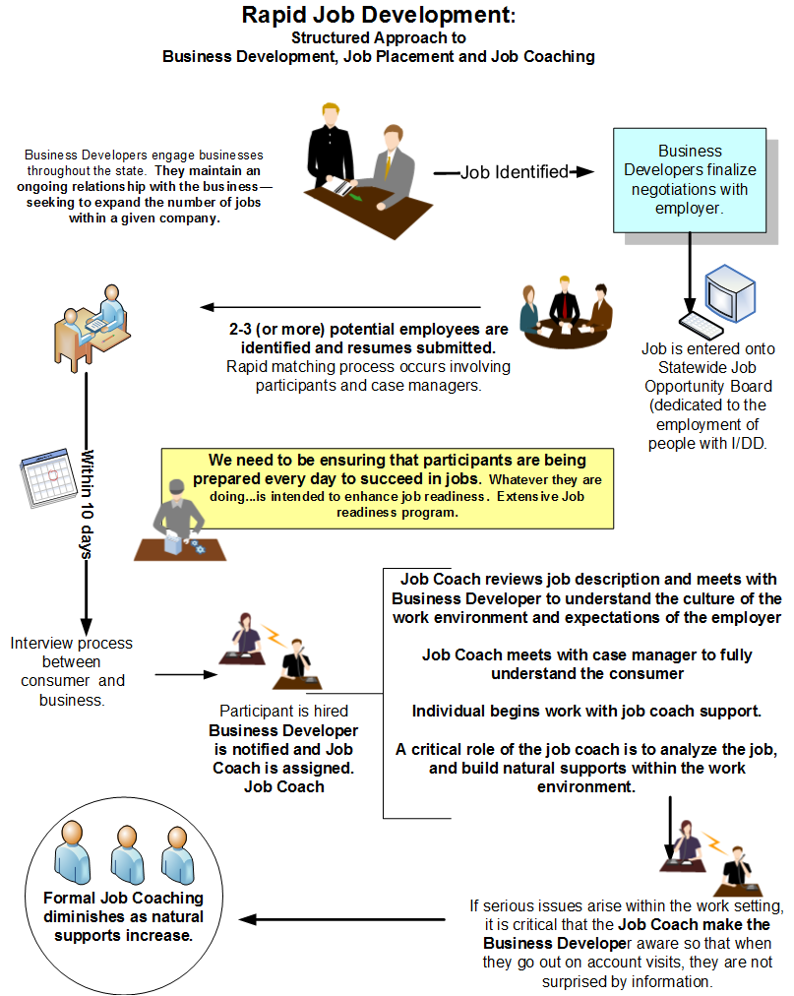

Slide 8
Concurrent Activities: Business Partners & Employee Readiness
Labor Sector
Analysis
Functional
Capacity Assessment
High Growth Sectors
Food Service/ Restaurant
Cashier
Dishwashing
Busing tables /filling water/bread baskets
Prep Cook
Hospitality
Housekeeping
Front Desk Support
Retail/Stocking
Light manufacturing
Construction
Janitorial/Facilities Management
Assess individual’s capacities in functional areas that contribute to employment success:
Stamina
Mobility
Clarity of speech
Working in teams
Following Directions
Sequencing of multiple tasks
Reading
Simple Addition
Conflict Resolution
Stress Management
Using Transportation
Flexibility

Slide 9
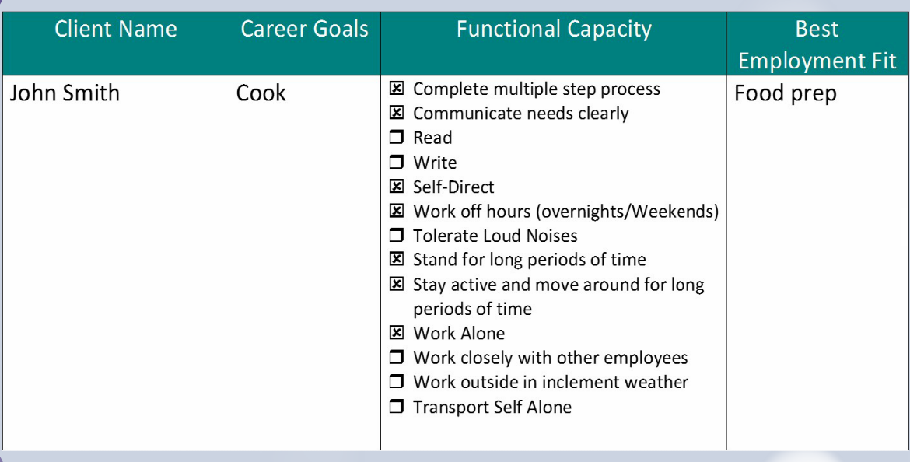
Functional Assessment Tool Sample

Slide 10
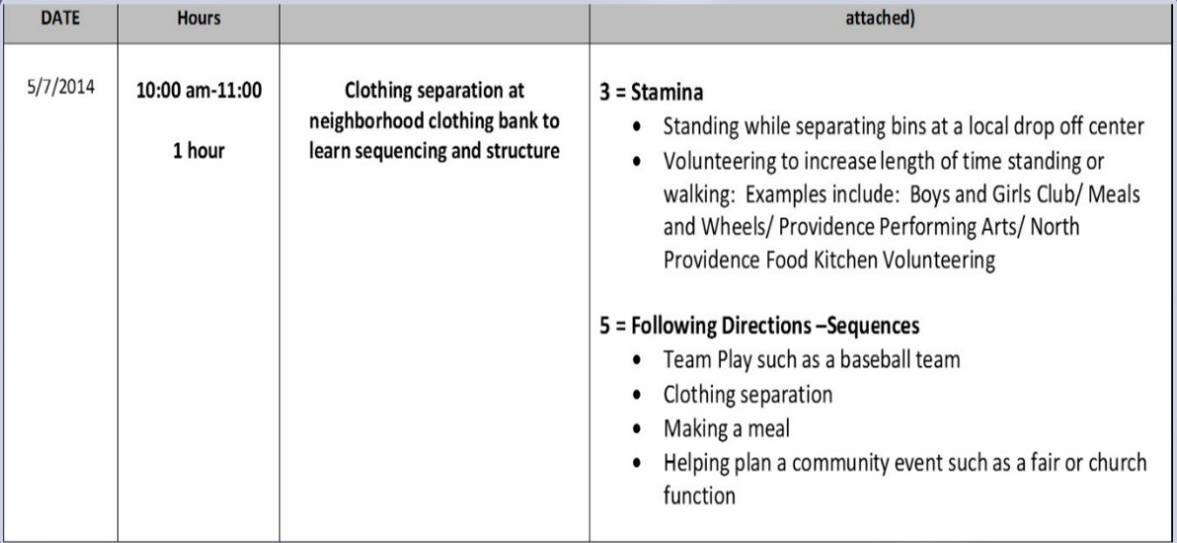
Integrated Day Activity Tool Sample

Slide 11
Concurrent Activities: Business Partners & Employee Readiness
Business Engagement
Get
Ready!™
Education
Examples
Commitment to the larger picture
Managing Expectations
Selling the “Team”
MOAs (larger companies)
WorkStar™ Certification
Web-based interactive work readiness curriculum -
Learning About Yourself
You have the Solution
Personal Branding
Career Pathways
Family Engagement

Slide 12
Concurrent Activities: Business Partners & Employee Readiness
Business Developers Roundtable
Connect2Careers™
Engage Business (Job) Developers from around the state
Ensure that there is a lead for each large business –creating a framework for engagement
Share effective messaging and tools
Share successes
Collectively problem solve
Create opportunity to practice skills from Get Ready!
35 businesses
100 participants
Resumes and business cards
Speed dating like event
Tremendous impact

Slide 13
Concurrent Activities: Business Partners & Employee Readiness
Employer Based Training
Development of Learning Pods
Dissect each business to understand specific employment opportunities
Create training modules (in partnership with business) that meets specific business needs
Kitchen becomes a “restaurant” -
Prep cook, busser, dishwashing, filling water glasses, cashier
Create a Hotel Room -
Make the bed, clean the mirror and dresser, vacuum, clean the bathroom
Create a Retail Space -
Stocking, sorting, sequencing

Slide 14
Concurrent Activities: Business Partners & Employee Readiness
Job Opportunity Board
Placement Process
http://www.cea.fedcap.org/job
Business Developers add employment opportunities
Access by consumers, guardians, advocates, case managers
Consumer, guardian case manager etc. identifies job opportunity
Contacts business developer to discuss opportunity
Business Developer works with company to schedule interviews
Business Developer introduces job coach

Slide 15
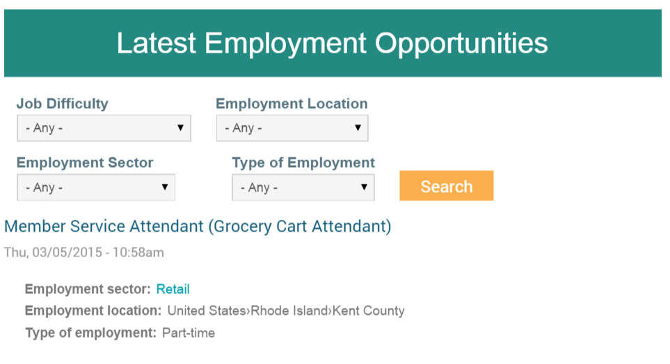

Slide 16
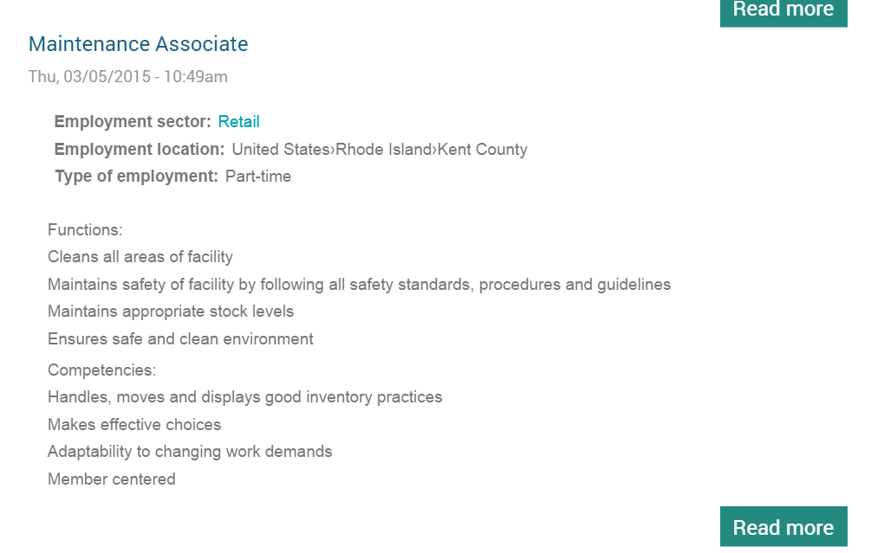

Slide 17
Concurrent Activities: Ongoing Business Partnership & Employee Success
Maintaining /Expanding Business Relationship
Job Coaching
Consistent contact and responsiveness
Identification of new job opportunities
Expansion of existing job responsibilities
Role of ambassador
Understanding culture and environment of business
Systematically developing natural supports
Job Coach Certification

Slide 18
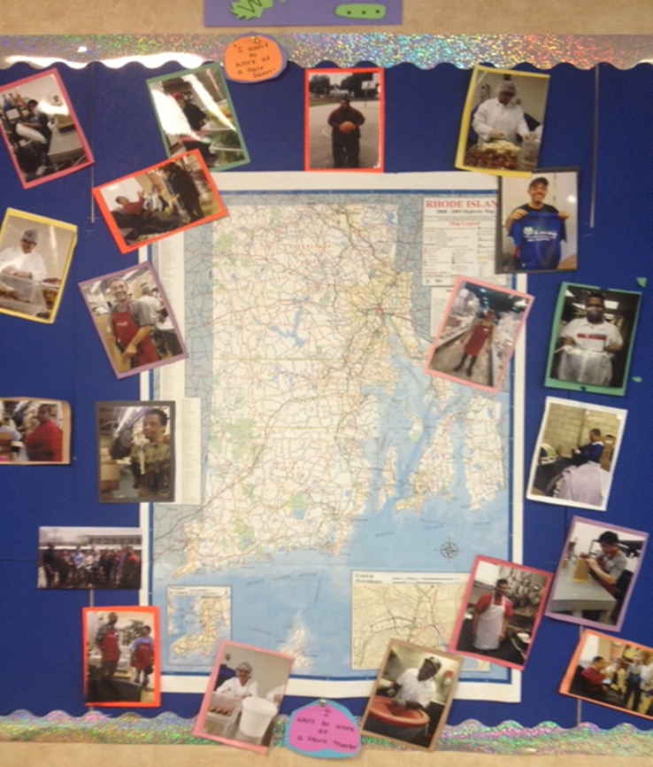
Reinforcing the Evolving Culture!
When a participant is hired— celebrate
Ring a Bell
Have popcorn!
Post pictures of individuals who have been hired posted
Use their hiring as a way to advance the enthusiasm of other participants ...and to inspire staff.
Hold a first Paycheck Celebration
Spotlight on websites http://www.cea.fedcap.org/success-stories
Develop a Peer to Peer Job Club

Slide 19
The Culture
“Coming together is a beginning,
Keeping together is progress,
Working together is success.”
Henry Ford

